Slide 1
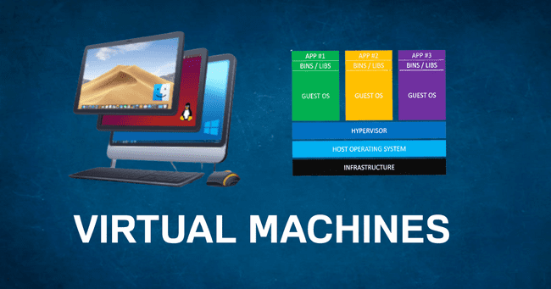
⚙️ Steps to Set Up a Virtual Machine in LocalStack 🖥️
BY
Madhurima Rawat

Slide 2

🌐 Deploying a Web Application on a Cloud Server 🚀
BY
Madhurima Rawat

Slide 3

🗂️ Working with AWS S3 Cloud Storage Services 💾
BY
Madhurima Rawat

Slide 4
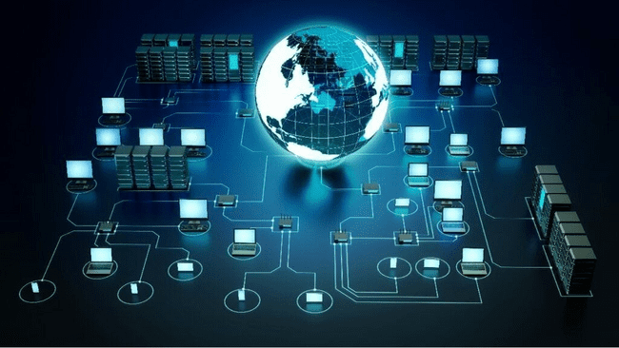
📡 Setting Up and Configuring Cloud Networking 🔐
BY
Madhurima Rawat

Slide 5

🛠️ Using Cloud Functions for Serverless Computing 🧩
BY
Madhurima Rawat

Slide 6
Code Refactoring
By Madhurima Rawat

Slide 7






Load Balancing and Auto Scaling
By Madhurima Rawat

Slide 8
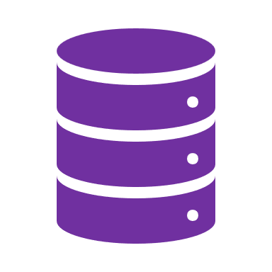



Cloud Databases and Data Management
By Madhurima Rawat

Slide 9




Cloud Identity and Access Management (IAM)
By Madhurima Rawat

Slide 10




Implementing Cloud Monitoring and Logging
By Madhurima Rawat

Slide 11

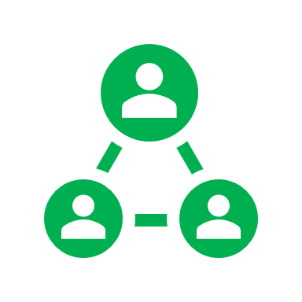

Setting Up Cloud-based CI-CD Pipeline
By Madhurima Rawat

